Slide 1

Portfolio
Project
Represented by :
Jagrati Sharma

Slide 2

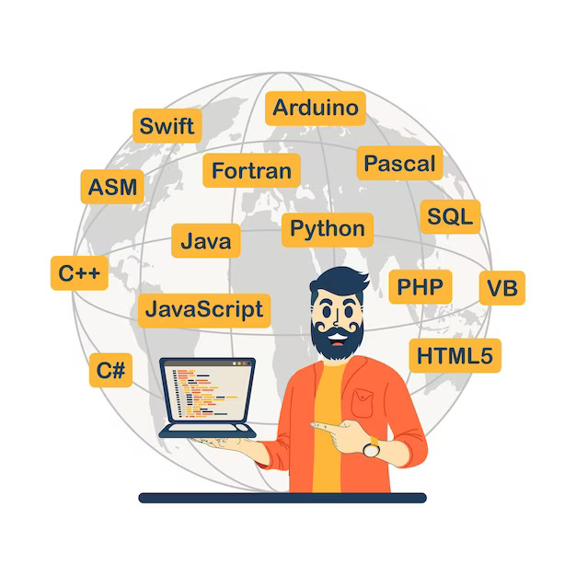
Contents
Introduction
Navigation Bar
Home Page
2.1
2.2
Hobbies
Skills
4.1
4.2
4.3
Certificate
5.1
5.2
5.3
Project
Contact

Slide 3

Introduction
I am Jagrati Sharma completed my academics from Shivalik Cambridge College, Agra and currently pursuing Btech from ABES Engineering College, Ghaziabad.
I have been working on the project of my portfolio.
The technologies used are :
HTML
CSS
BOOTSTRAP
JAVASCRIPT

Slide 4
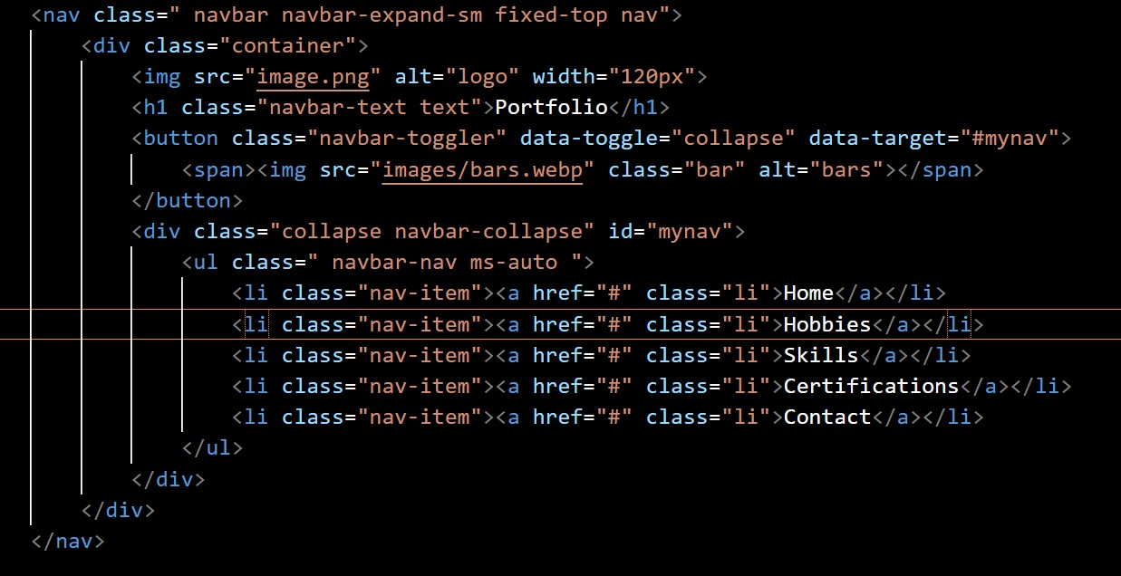
Navigation Bar
Code snippet:
In my portfolio project, I used a navigation Bar that contains various things listed below:
A Logo
Brand Name
Hyper links includes:
Home
Hobbies
Skills
Certificates
Contact
In this navigation bar, the technology used are:
HTML
CSS
Bootstrap
OUTPUT:

Slide 5
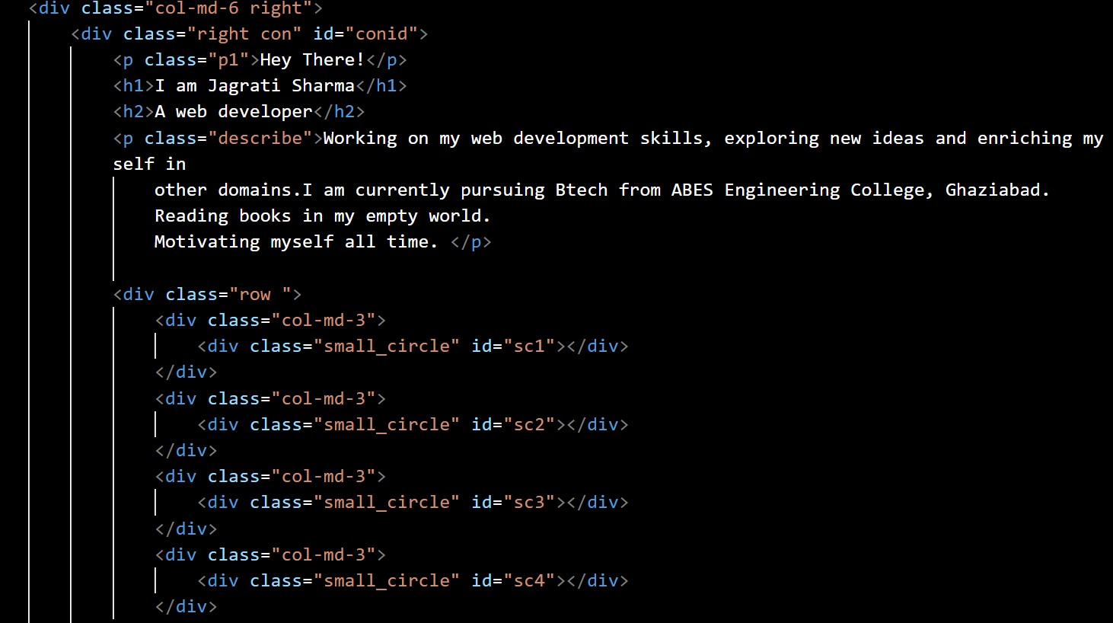
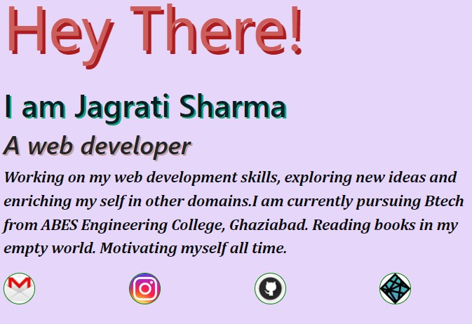
2. Home Page
2.1
After the navigation bar, I have created a Home page where I tell about myself in an attractive way.
The home page is divided into two section:
First section contains some text that partially defines myself and some small icon that includes my Instagram id, GitHub link, Netlify link and Gmail account.
The colour combination used:
Lavender
Teal
Code Snippet:
Output:

Slide 6

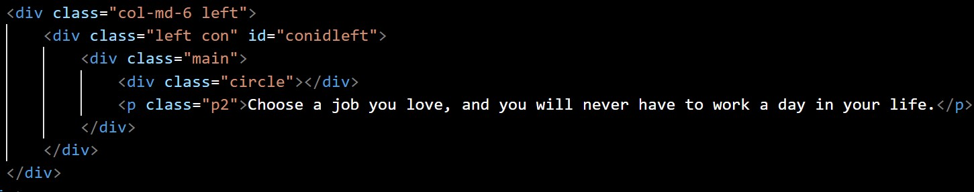
2. Home Page
2.2
Along with the first section of my home page I have created second section with the help of Bootstrap , it will also be responsive in any device.
The contents are:
An image
A quote
The colour combination used:
Lavender
Teal
With the white text.
Output:
Code Snippet:

Slide 7
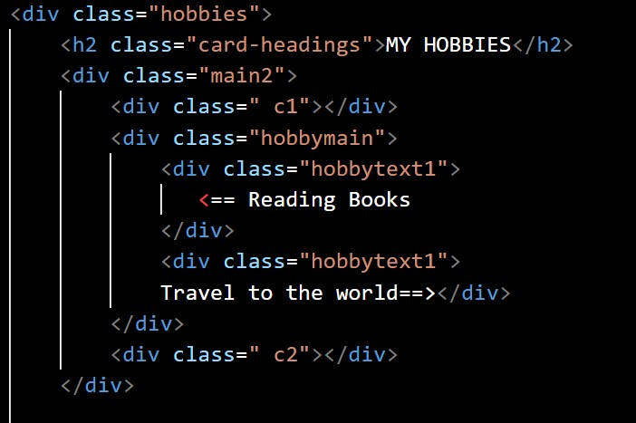

3. Hobbies
Code Snippet:
After my home page, I would like discuss about my hobbies. So in this context, I have created a division with the background image .
Then by the help of “Display: flex; “ I would be able to align it perfectly.
There are two images:
Reading Books with the text
Travelling the world along with the text
Output:

Slide 8
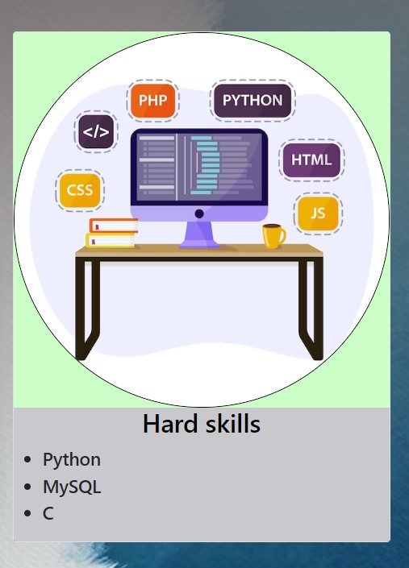
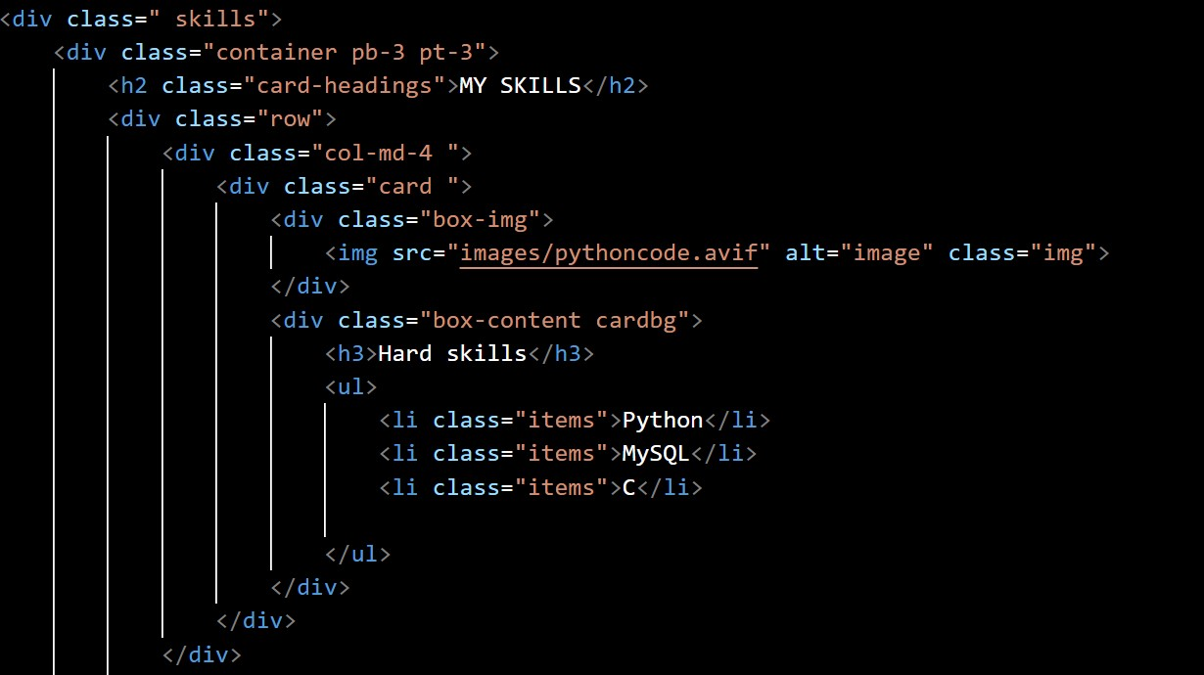
Skills
4.1
After hobbies I would like to discuss my skills.
This section is divided into 3 parts with help of bootstrap. I have also added a background image.
1st Part:
It contains my hard skills like Python, MySQL and C language.
Image is also included.
Output:
Code Snippet:

Slide 9
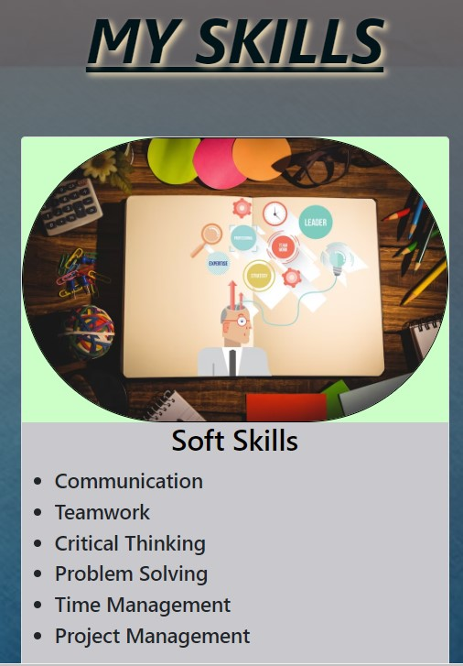
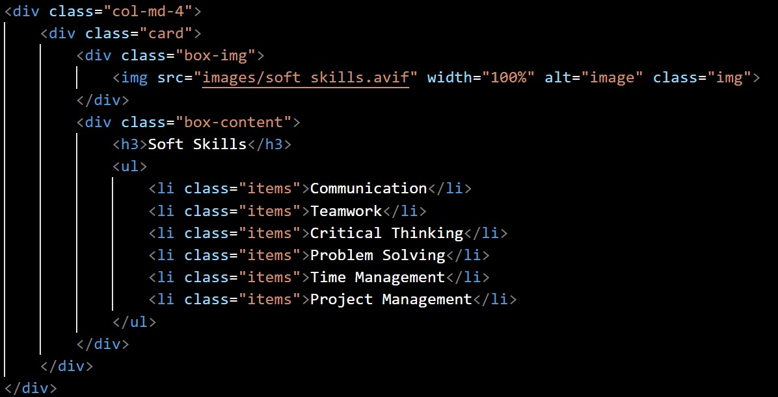
Skills
4.2
Output:
2nd Part:
It contains my Soft skills like communication skills, collaboration, time management, project management, critical and analytical thinking.
An image is also added to look it more attractive . I have defined the different background to it.
Code Snippet:

Slide 10
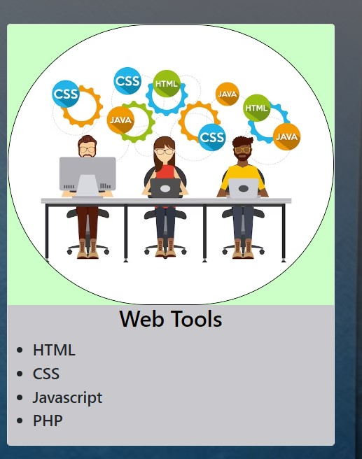
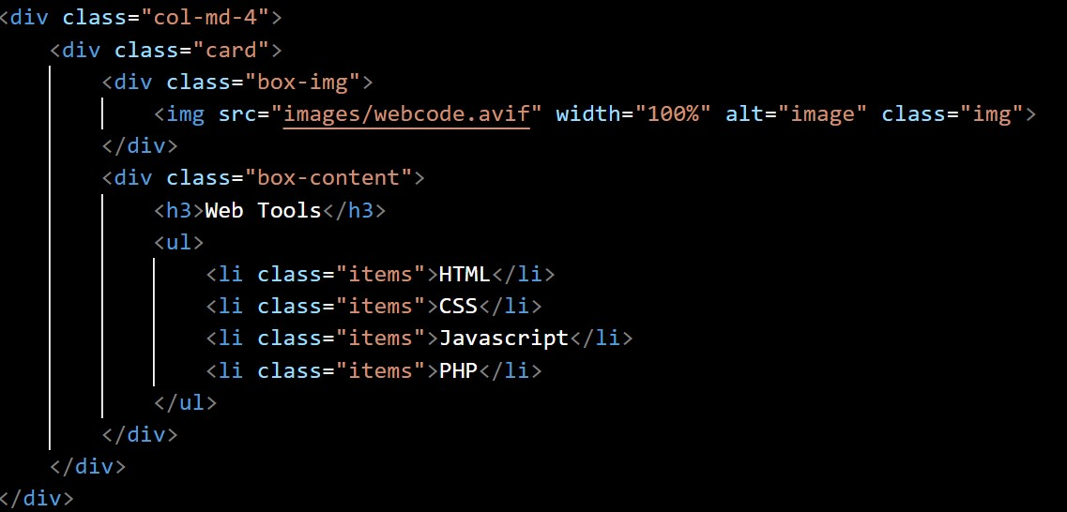
Skills
4.3
3rd Part:
It contains my Web Technical skills like HTML , CSS, Bootstrap, PHP and JavaScript.
An image is also added to look it more attractive . I also add the background color in it.
Output:
Code Snippet:

Slide 11
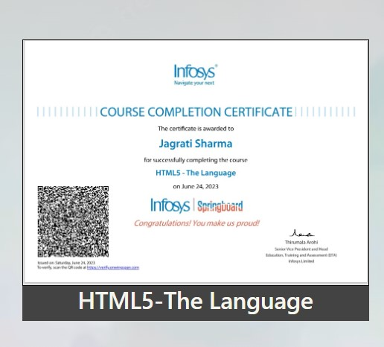
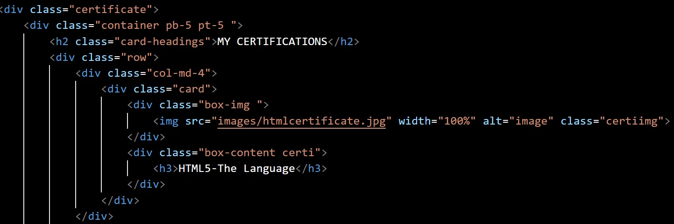
5. Certificates
5.1
After introducing my skills , I want to add my some certificates.
This section is also divided into 3 parts with help of bootstrap with a background image.
1st Part:
It contains my HTML-5 certificate from Infosys springboard.
Output:
Code Snippet:

Slide 12
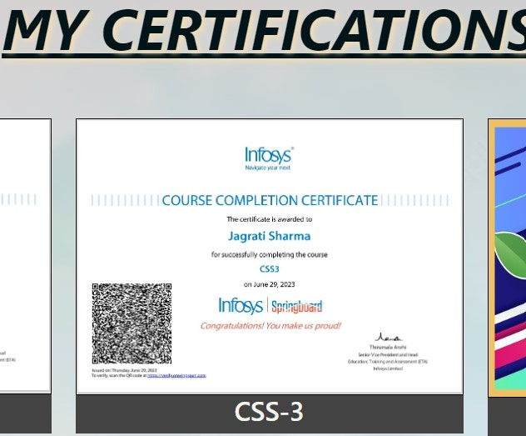
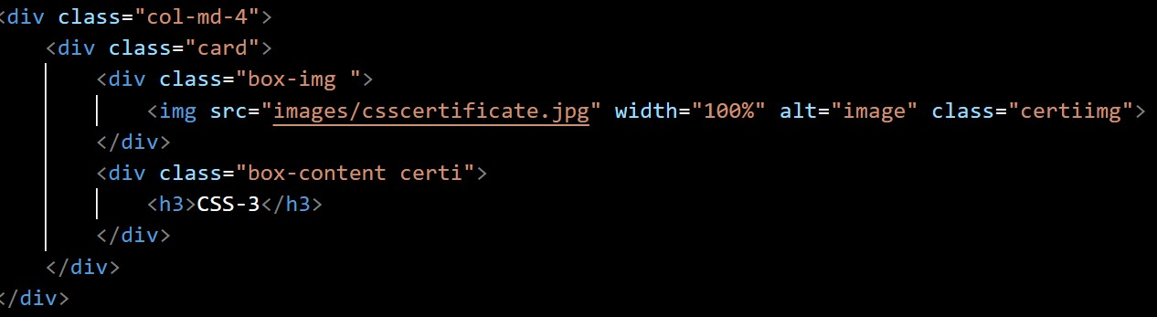
5. Certificates
5.2
2nd Part:
It contains my second certificate of 3 Cascading Style Sheets CSS3 from Infosys wingspan .
An image is also added to look it more attractive . I have defined the different background to it.
Output:
Code Snippet:

Slide 13
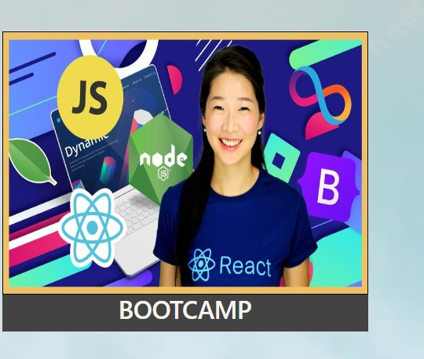
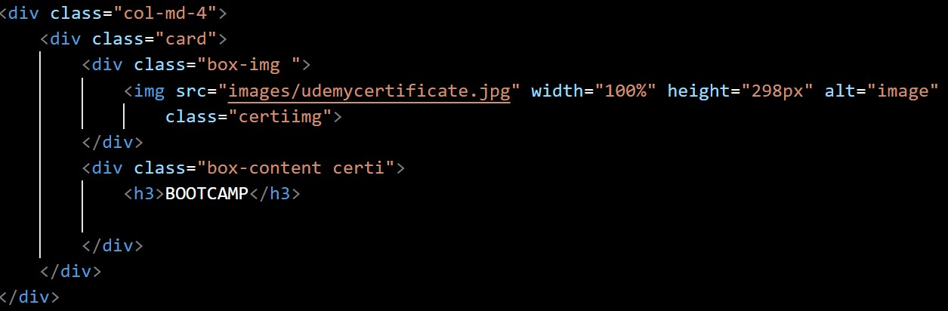
5. Certificates
5.3
Output:
3rd Part:
It has my bootcamp training which is in running and soon I will complete it successfully.
An image is also added to look it more attractive . I also add the background color in it.
Code Snippet:

Slide 14
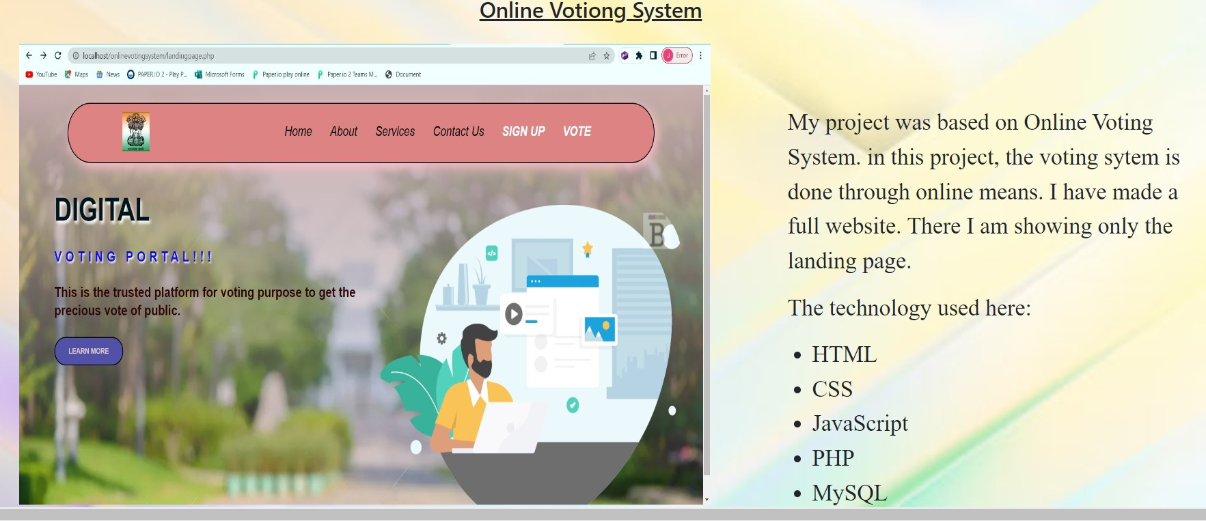
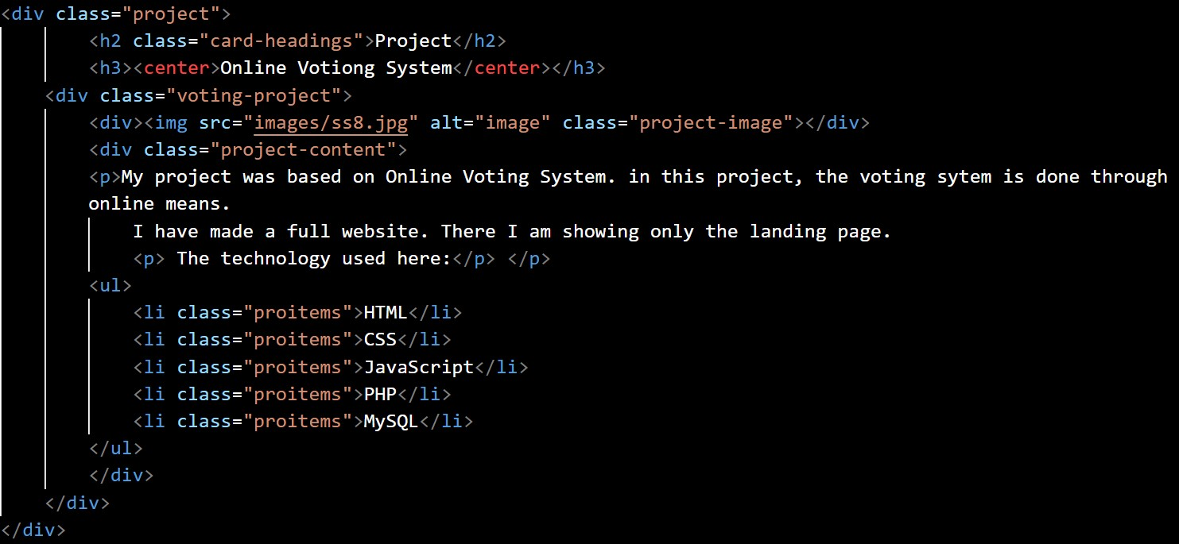
6. Project
There I have attached my recent made project which is based on Online Voting System.
The technology used here:
HTML
CSS
Output
Code Snippet:

Slide 15
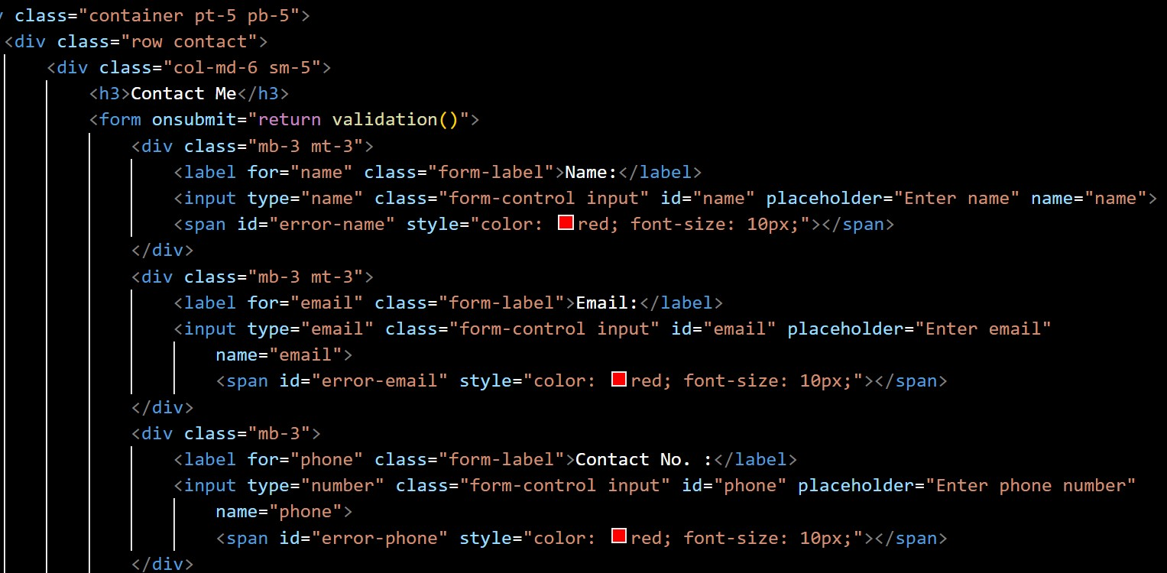
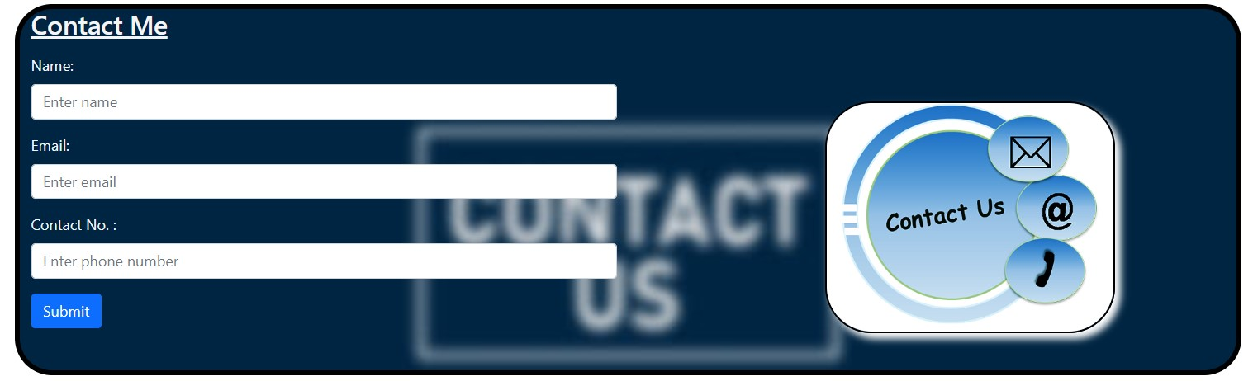
Contact
6.1
Here I put the form where for those who want to contact me.
In this form, following details are required:
Name
Email
Contact Number
Then there is a submit button also .
Here I use HTML and CSS.
Code Snippet:
Output:

Slide 16
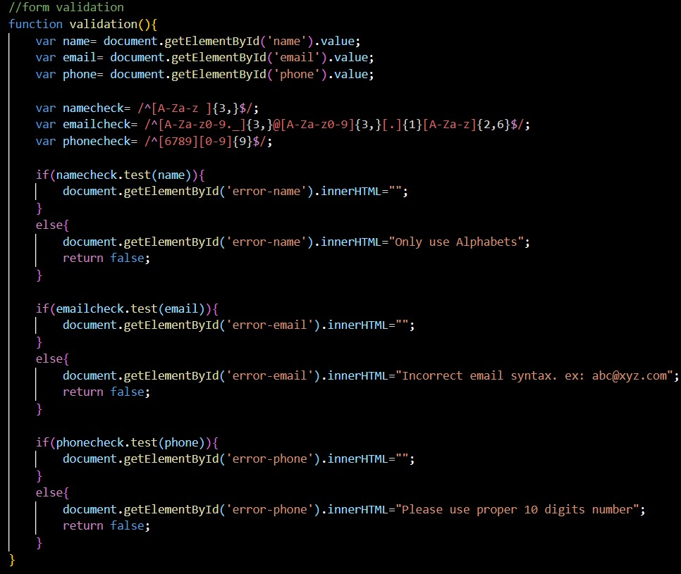
Contact
6.2
Code Snippet:
Here I put the JavaScript in this form, following functions are required:
Name validation
Email validation
Contact Number validation
The Submit button is required to submit the form.
Here I use JavaScript.

